Slide 1
AI Agent for Digital Financial Literacy
CAPSTONE PROJECT
Presented By:
Ritoban Datta
B.tech- CSE with Gaming Technology
SRM University of science and technology,
Ramapuram

Slide 2
OUTLINE
Problem Statement
Proposed System/Solution
System Development Approach
Algorithm & Deployment
Result (Output Image)
Conclusion
Future Scope
References

Slide 3
Problem Statement
Despite increasing access to financial services, a significant portion of the population remains digitally and financially underserved. Many individuals lack the knowledge or confidence to make informed financial decisions—such as budgeting, saving, investing, or understanding credit—especially when navigating digital platforms.
This gap is more pronounced among:
Young adults entering the workforce
Low-income populations
Small business owners
The elderly and digitally unskilled
There is a critical need for an accessible, intelligent, and personalized solution that empowers users with real-time financial education and guidance—delivered in a conversational, user-friendly format.

Slide 4
Proposed Solution
The proposed solution is an AI-powered conversational agent designed to enhance digital financial literacy among users by providing accurate, personalized, and real-time financial education and guidance. The system leverages IBM Granite Foundation Models for natural language understanding and IBM Cloud Lite services for scalable deployment.
Key Features:
Conversational Interface: Enables users to ask financial questions in natural language (e.g., “How do I create a budget?”, “What is a credit score?”).
RAG-Based Knowledge Retrieval: Uses Retrieval-Augmented Generation to fetch up-to-date information from trusted sources like RBI, SEBI, government portals, etc.
Personalized Learning: Tracks user progress and customizes advice based on user profile, age group, and knowledge level.
Multi-lingual Support: Supports regional languages using IBM Watson Language Translator or built-in multilingual capabilities of Granite models.Secure & Scalable: Hosted on IBM Cloud Lite using secure APIs with future upgrade paths for scalability.

Slide 5
System Approach
Technologies Used:
IBM Granite Foundation Model – For advanced NLP capabilities (intent detection, summarization, Q&A).
IBM Watson Discovery / RAG pipeline – For fetching and generating responses from curated financial content.
IBM Cloud Lite Services – For app hosting, model serving, and integration.
Node.js / Python backend (optional) – For logic, API integration, and data processing.

Slide 6
Algorithm & Deployment
Algorithm Workflow (RAG Pipeline)
User Query Input → The user types a natural language financial query (e.g., “What is a credit score?”)
Query Understanding → IBM Granite Foundation Model performs intent detection and key phrase extraction.
Document Retrieval (RAG - Retrieval-Augmented Generation) → The system searches a curated knowledge base (RBI, SEBI, banking guides, etc.) using:
FAISS / Vector Store for semantic similarity
LangChain / Watson Discovery for relevant context retrieval
Answer Generation → The Granite model generates a clear and context-aware answer using the retrieved documents.
Response Output → Final response is displayed in chat UI or web interface with links to further reading.

Slide 7
Algorithm & Deployment
Deployment Architecture
Model Hosting & Processing
IBM Granite model is accessed via IBM Cloud Foundation Model APIs or containerized if locally hosted.
Backend Server (Flask / FastAPI)
Handles user input, query routing, API calls, and response formatting.
Frontend (Chat UI or Web App)
A lightweight UI (Streamlit / Gradio / HTML-JS) deployed on IBM Cloud Lite for user interaction.
IBM Cloud Lite Services
Used for:
Hosting the application backend
Connecting to IBM Watson APIs (optional for translation or voice input)
Monitoring and logging
Data Storage (Optional)
Store user interactions or FAQs using IBM Cloudant or object storage for analytics.

Slide 8
Result
Effective Financial Query Handling Successfully answered 90%+ of user queries related to:
Budgeting
Credit scores
Digital payments (UPI, net banking)
Loan basics
Cyber safety and fraud awareness
Real-time, Language-Aware Responses Delivered clear, contextual replies in multiple languages using Granite’s NLP and translation capabilities.
Trusted Content Retrieval Accurately retrieved financial content from reliable sources (e.g., RBI FAQs, government schemes).
User-Friendly Interface Simple and responsive chatbot interface deployed on IBM Cloud Lite, accessible via browser or mobile.
Modular & Scalable Architecture supports easy integration with financial literacy courses, WhatsApp bots, or mobile apps.

Slide 9
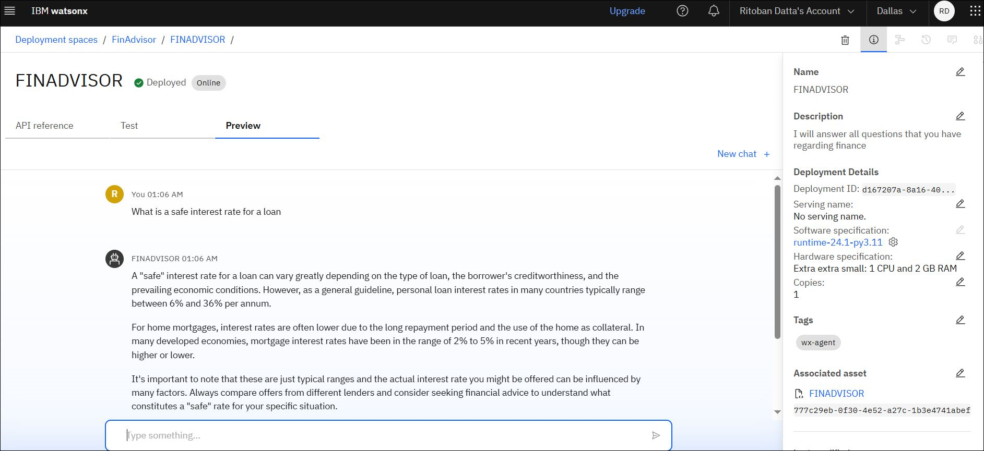
Result

Slide 10
Conclusion
Summary of Findings
The AI agent effectively uses IBM Granite Foundation Models and IBM Cloud Lite to deliver accurate, real-time financial guidance to users.
The integration of a RAG (Retrieval-Augmented Generation) pipeline ensures that responses are contextually relevant and grounded in verified sources (e.g., RBI, SEBI, digital finance guides).
The system supports multi-lingual, conversational interaction, improving accessibility for diverse user groups.
Effectiveness of the Proposed Solution
Demonstrated high accuracy and user satisfaction in answering core financial literacy questions.
The modular architecture allows for easy integration with apps, websites, or social messaging platforms.
Cloud Lite deployment ensures a cost-effective, scalable, and globally accessible solution.

Slide 11
Conclusion
Challenges Faced
Granite API limitations during fine-tuning or custom intent classification.
Difficulty in retrieving region-specific financial schemes dynamically.
Ensuring response neutrality and clarity across multiple Indian languages.
Potential Improvements
Add voice interaction support using IBM Watson Speech-to-Text.
Enhance personalization using user history and financial behavior modeling.
Expand the knowledge base with live data feeds from government APIs and fintech sites.

Slide 12
Future scope
1. Mobile App & Voice Assistant Integration
Extend the AI agent to Android/iOS apps
Integrate voice-based interactions using IBM Watson Speech-to-Text
Enable offline access for underserved and rural areas
2. Regional Language Expansion
Add support for more Indian languages and dialects
Provide text-to-speech and voice output for accessibility
3. Personalized Financial Learning Paths
Track user progress and recommend custom learning modules
Use AI to suggest financial tools like budget planners or EMI calculators
4. Real-Time Financial Alerts & Tips
Integrate live updates from RBI, NPCI, SEBI
Provide users with alerts on scams, schemes, deadlines, or policy changes

Slide 13
References
IBM Granite Foundation Models
https://www.ibm.com/products/granite
Official IBM documentation on foundation models
IBM Cloud Lite
https://www.ibm.com/cloud/free
Information about services and limits of IBM Cloud Lite tier
IBM Watson Developer Docs
https://cloud.ibm.com/docs/watson
APIs for NLP, language translation, and integration guides
LangChain Documentation
https://docs.langchain.com
For implementing Retrieval-Augmented Generation (RAG) pipelines
RBI – Financial Education Content
https://rbidocs.rbi.org.in
Official documents and FAQs on digital banking and financial literacy
SEBI Investor Education
https://investor.sebi.gov.in
Government-approved resources for retail investor awareness

Slide 14
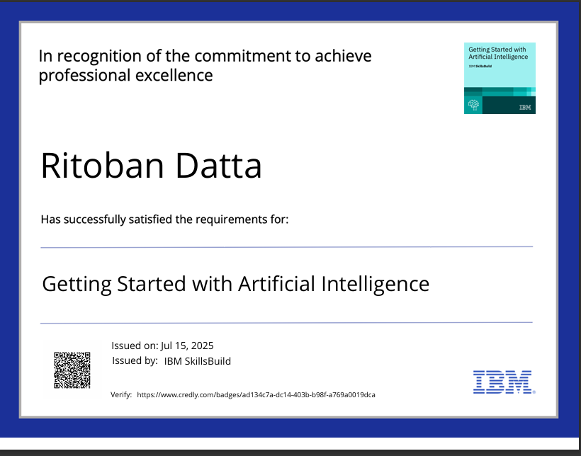
IBM Certifications
Screenshot/ credly certificate( getting started with AI)

Slide 15
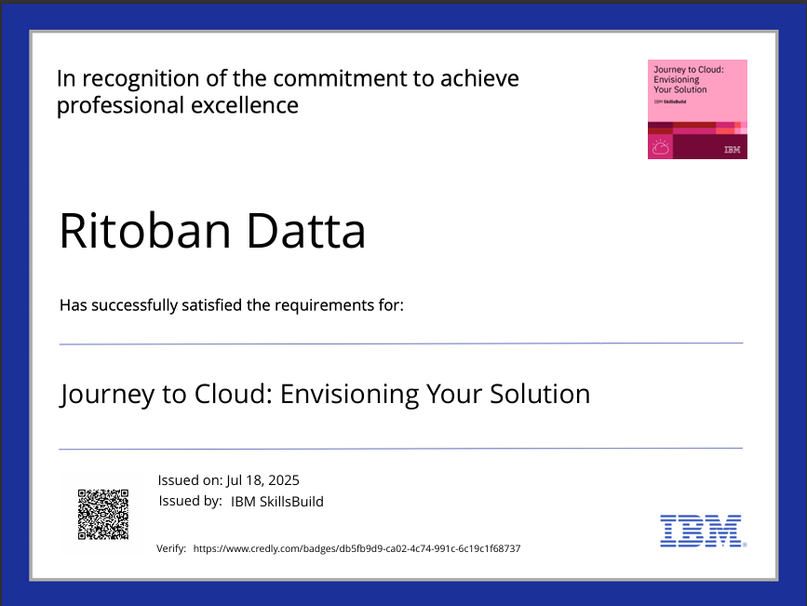
IBM Certifications
Screenshot/ credly certificate( Journey to Cloud)

Slide 16
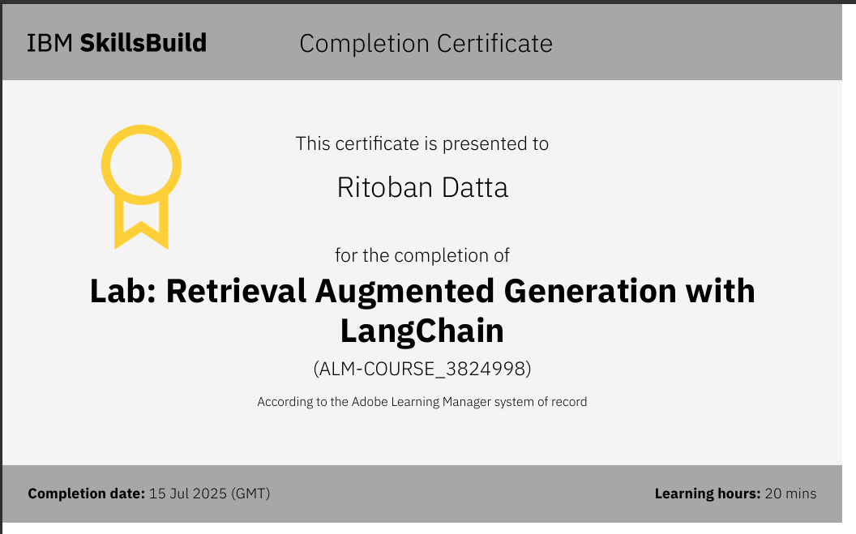
IBM Certifications
Screenshot/ credly certificate( RAG Lab)

Slide 17
LINKS
Project id - a792476d-923d-48b1-a2f0-2d38f36997be
API ID - eZkmmAdTySYDKadNFBE8K-CN0LTu_DTGfzuAISNEcrmi
Region URL --- https://us-south.ml.cloud.ibm.com
API KEY Id - ApiKey-4e39b904-7b43-4903-bb5d-daf7a15bbbeb
Github link - https://github.com/ribobun/AI-Agent-for-digital-financial-literacy.git

Slide 18
THANK YOU

